Slide 1

Mango IT Solutions
Placement Drive for Associate Software Engineer

Slide 2

Mango IT Solutions
ISO-certified best LAMP company of Central India.
15+ years of expertise in web and ecommerce development.
100% exports company with client base in USA, UK, Europe & Australia.
Web and mobile development company, working extensively on LAMP and Full Stack Development .
Specialize in web applications-ecommerce, mcommerce, CMS, custom and SAA Sapplications.

Slide 3
About Us
Brand company of Any Linux Work Pvt. Ltd.
7+ years trained working professionals.
World class and environmental friendly infrastructure
75+ team strength & growing

Slide 4
Life @ MIT
Work
Proper organization structure including work hierarchy
Attention to detail and perfection
Framework based coding with latest technologies
Regularity in work
5 Days in a week working

Slide 5
Life @ MIT
Fitness Lifestyle in Work:
Cycle to work
Ergonomically sitting and standing furniture
Open work Infrastructure with proper lighting and ventilation
Morning and evening snacks
Regular fitness and outdoor excursions
Celebration
In house sports competition
Festival and individual celebrations with team
Happy and respectful atmosphere with smiles

Slide 6
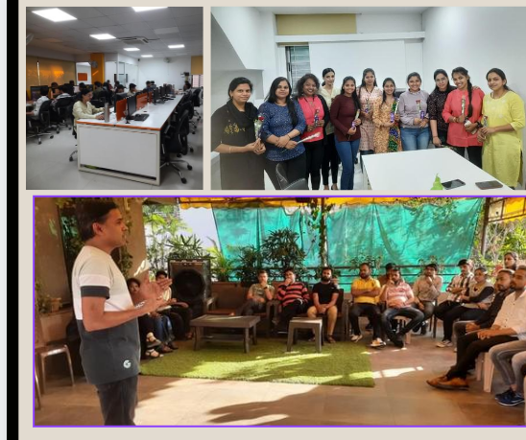
Glimpses of Events

Slide 7
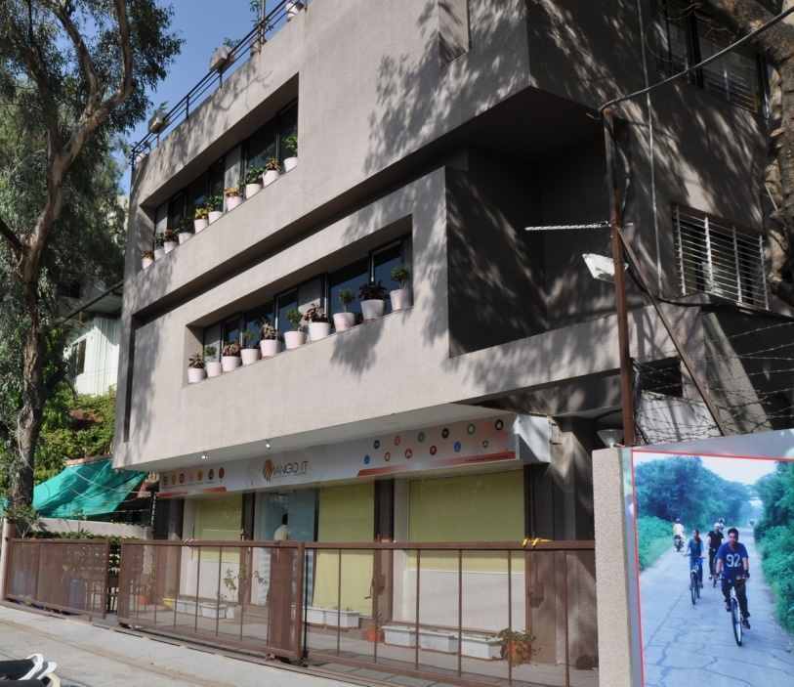
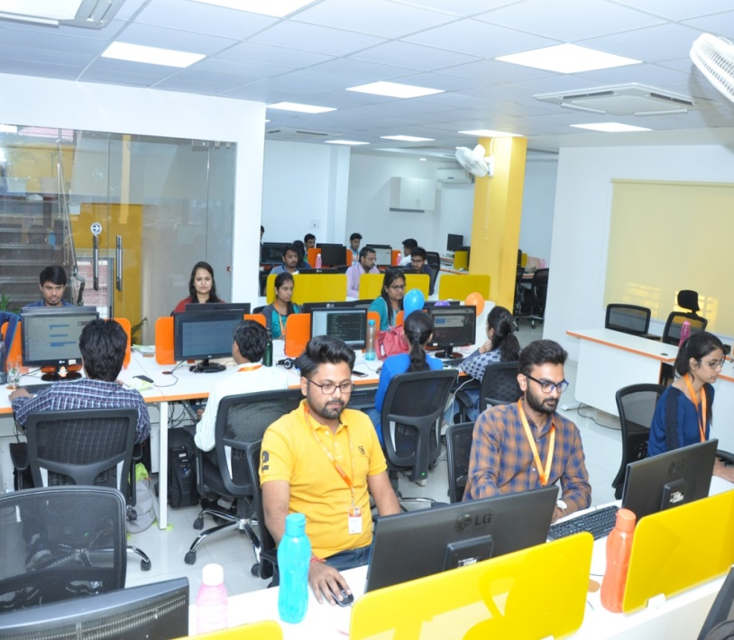
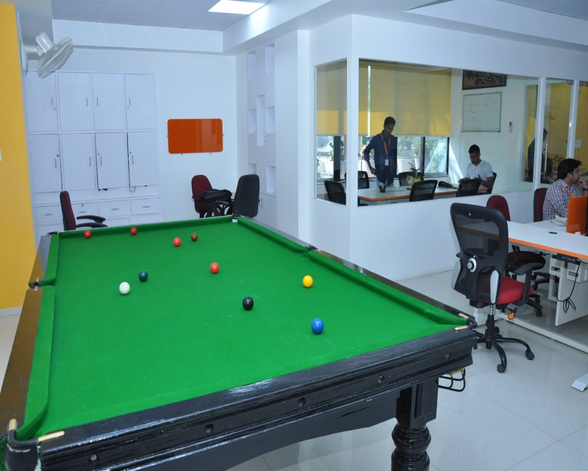
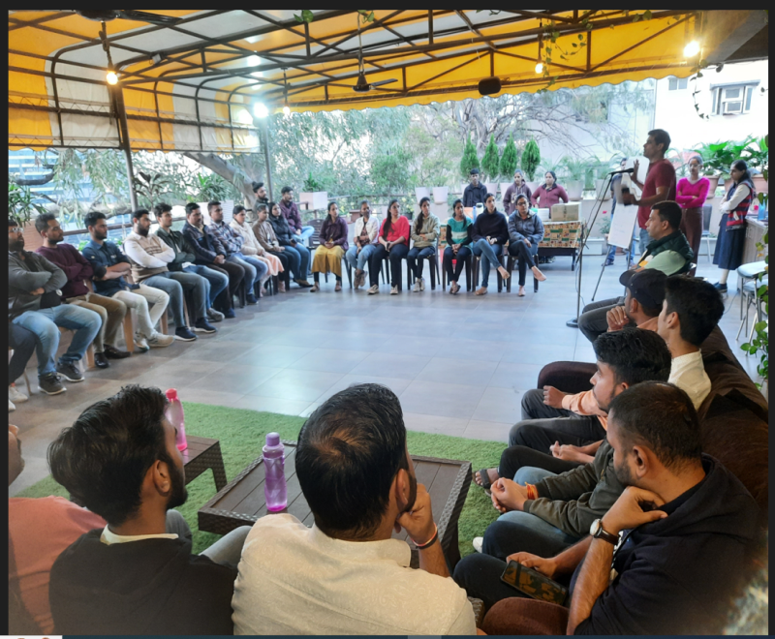

Slide 8
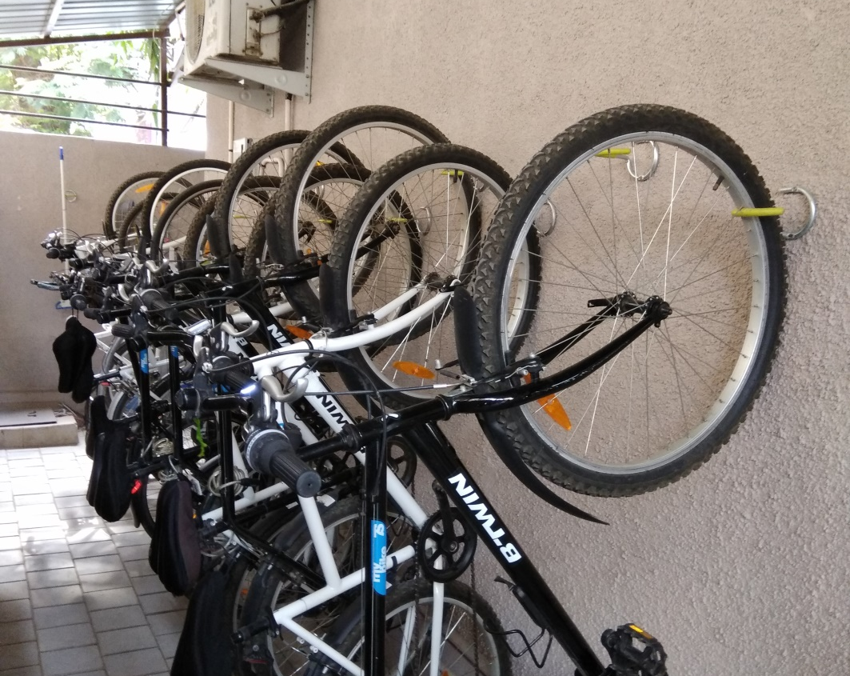
We are known for our Fitness Activities throughout the year
Cycle to Work

Slide 9
Work Culture
9:30 AM to 7:15 PM with flexible 45 minutes timing
5 days a week.
18 annual leaves
Clear and written HR policies
Open and transparent work culture

Slide 10
Training Program at MIS; What makes us different
6 months extensive training program
On job training with Projects and practical assignments
Stipend during training period
Master OOPS concepts and MVC architecture
Work under the direct supervision and guidance of project managers

Slide 11
Compensation and Terms
Stipend Rs. 10,000 per month for six months
Attractive salary
“ Contract for Training”
Retention bonus benefits
2.5 yrs. Of “ Contract for Training”
10th & 12th original documents to submit
CTC | Work Tenure
3.85 LPA | 1-18 Months
5.05 LPA | 19-30 Months
5.65 LPA | 31-42 Months

Slide 12
Retention bonus benefits
Retention Bonus :
Retention Bonus is offer to fresher’s batch on following terms
After completion of 3 yrs. tenure with company Rs. 1,80,000/- will be paid as retention bonus
After completion of additional 1 yrs. (total 4 yrs.) tenure with company Rs. 1,20,000/- will be paid as retention bonus
Note : At nutshell, fresher’s batch can get Rs. 3,00,000/- = ( 1,80,000 + 1,20,000 ) retention bonus after completion of 4 yrs. with company.

Slide 13
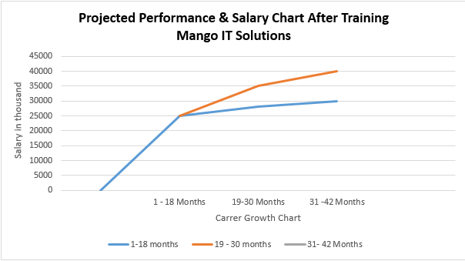
Projected Performance & Salary Chart

Slide 14
Projected Career Growth Plan

Slide 15
Training Module
THEORETICAL TRAINING
12) CodeIgniter
13) Laravel 14) Wordpress 15) Functional Training of ecommerce 16) Functional Training of CMS 17) Quality Analysis 18) PLC (Project Life Cycle) 19) PD Classes
1) HTML& HTML 5
2) Responsive Web Design
3) Introduction to PHP
4) OOPs in PHP
5) Javascript
6) Jquery Introduction
7) Database
8) React
9) Angular
10) Node
11) Magento 1.x, 2.x

Slide 16
Training Module
LIVE PROJECT TRAINING
Learn best practices with experienced senior software professionals
Work with UI Designers & Quality Analysts for module Development
Pre and post coding documentation
Opportunity to work on live modules and client interaction

Slide 17
Where to starts your IT career
Differentiation | MNC | Mid-size | Startup
Brand Value | Quiet high | Competitively less | Very less
Learning Curve | Competitively less | Quiet high | Very less
Project involvement | Competitively less | Quiet high | Very less
Market Value | Quiet High | Competitively less | Very less
Skill set | Competitively less | Quiet high | Very less
Work Culture | Very Strict | Lively and fun filled | Favorable working environment
Live Project Experience | Very rare | Every time | Depends on projects

Slide 18
Training Benefits
Advance level training for 3-6 months.
Training consist basic to advance module.
In-house experienced trainers.
Training on latest tools and technologies.
On job training with Projects and practical assignments
Exposure to work on live-project.
Mentor-Mentee system
Daily/weekly assignment system.
Assignment on every task.
Scrum Masters Certified Seniors
More than 10+ years experienced trainers.
Training on entire project development life cycle

Slide 19
Eligibility Criteria
Graduates with BE/PG degree in CS/ IT and 6+/10 grade
Coding experience in any technology with clear oops concepts.
Dedicated personality with a zeal to learn & good command on English.
Should be able to clear the technical interview and on-line test based on Quantitative Aptitude, English, MySQL, Logical Reasoning and Programming concepts.

Slide 20
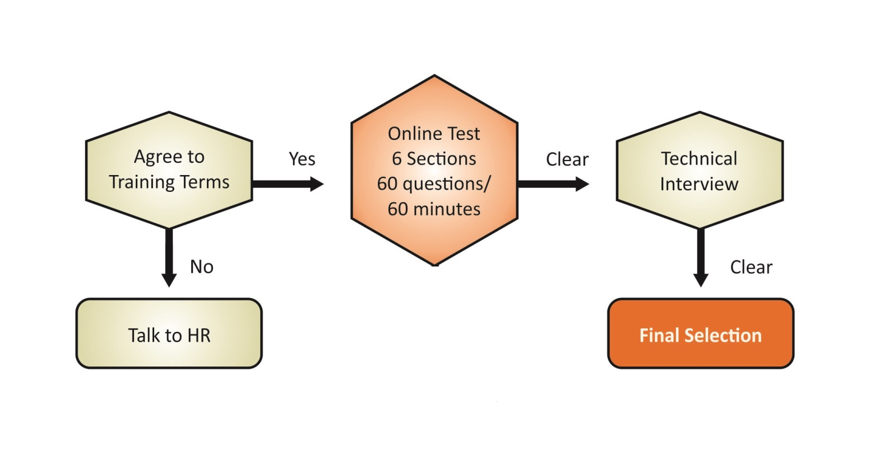
Selection Process

Slide 21

Any Questions ???
Vaishnavi Panchbhai – HR Executive
Mango IT Solutions 15/3 Old Palasia, Behind Sarda House, Indore Phone No. : 4044117, 4046693 Ext. 21/22
career@mangoitsolutions.com
hr@mangoitsolutions.com

